Slide 1
ETHICAL HACKING INTERNSHIP PROJECT SUBMISSION
_By Sarvesh Teware

Slide 2
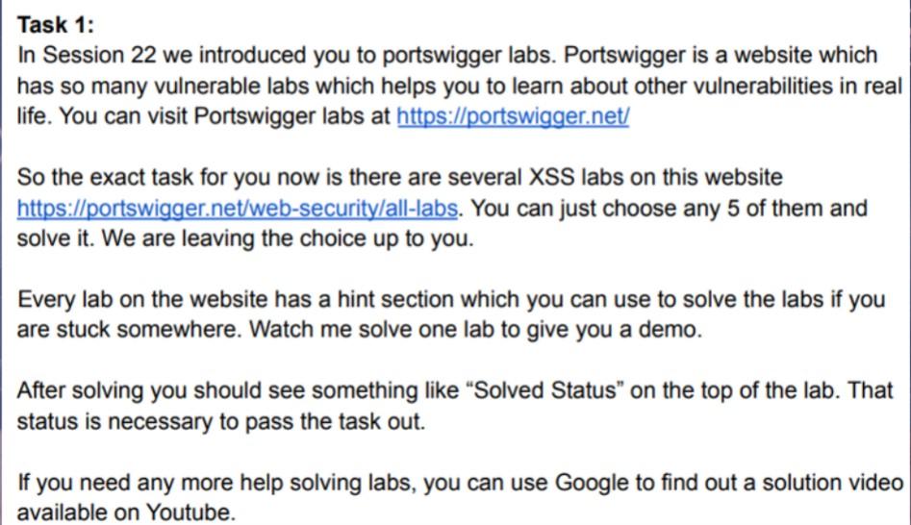
Project Problem Statement:

Slide 3
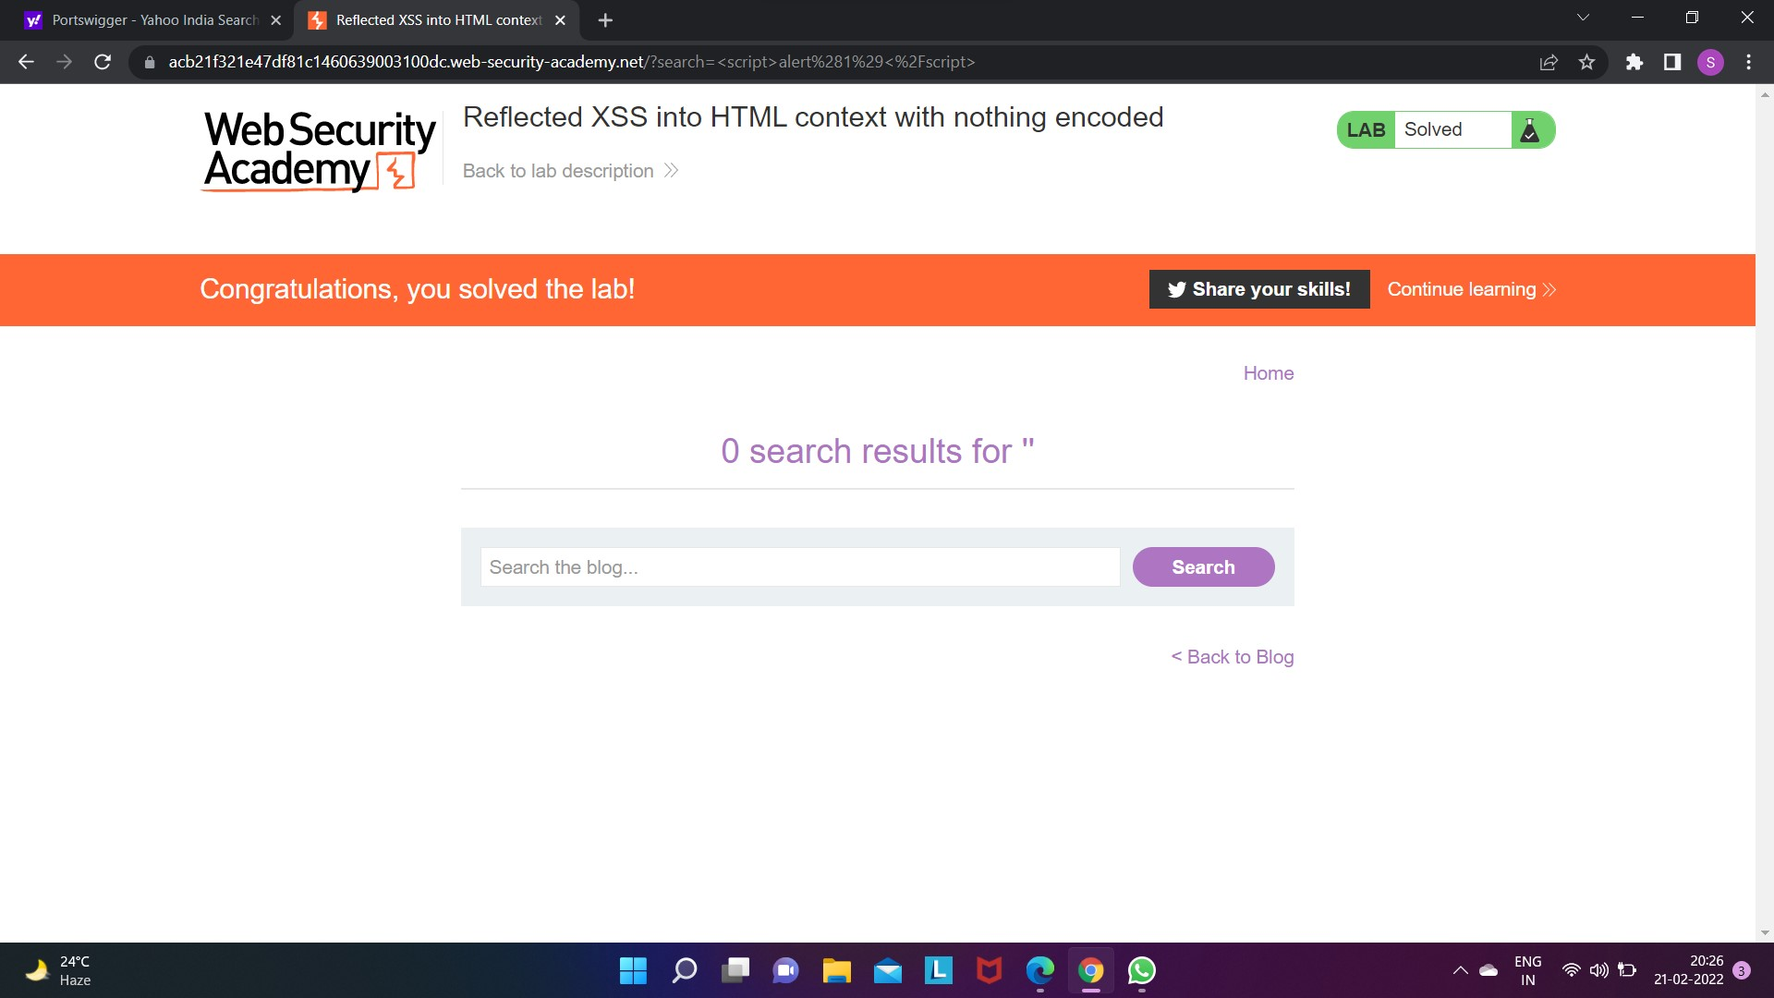
Lab 1 :-

Slide 4
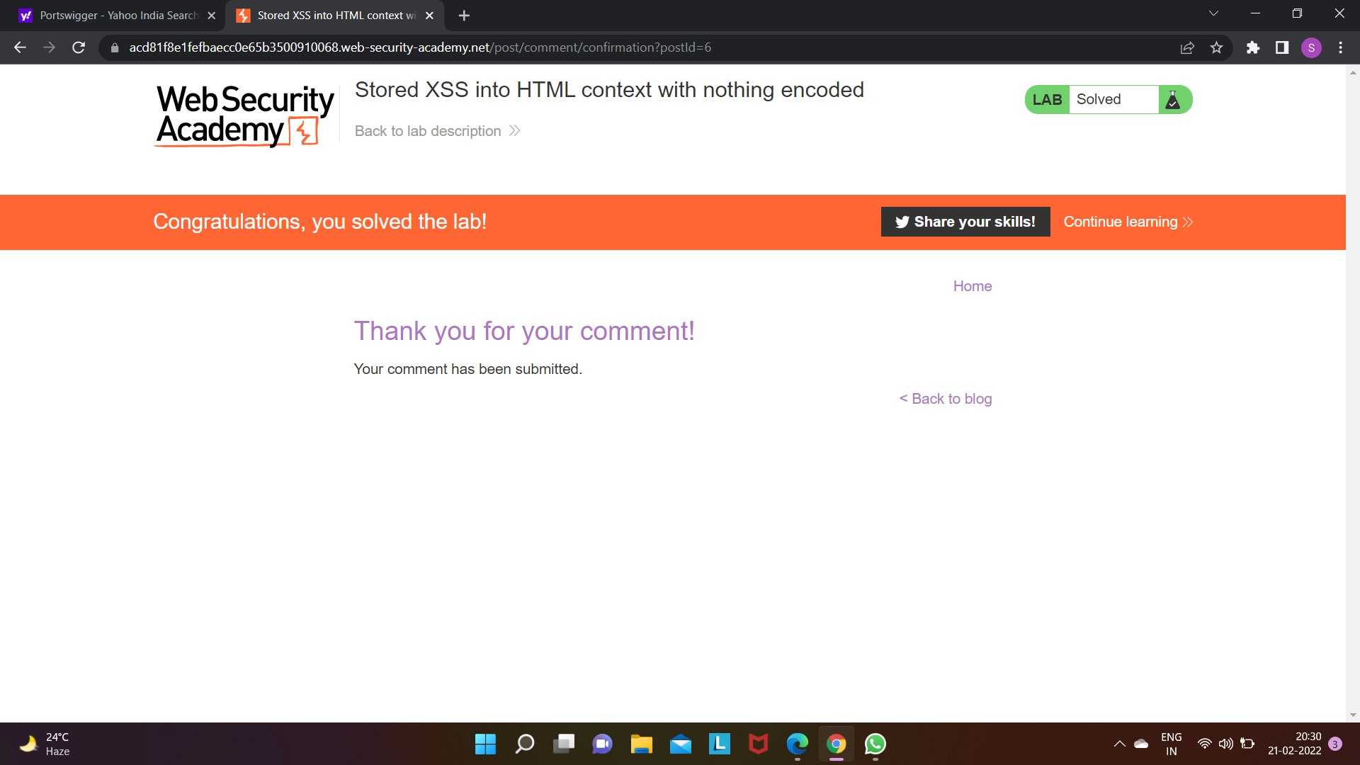
Lab 2 :-

Slide 5
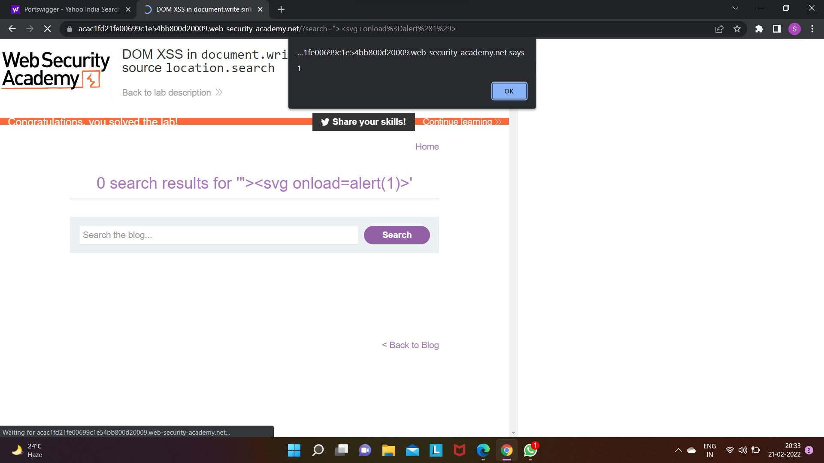
Lab 3 :-

Slide 6
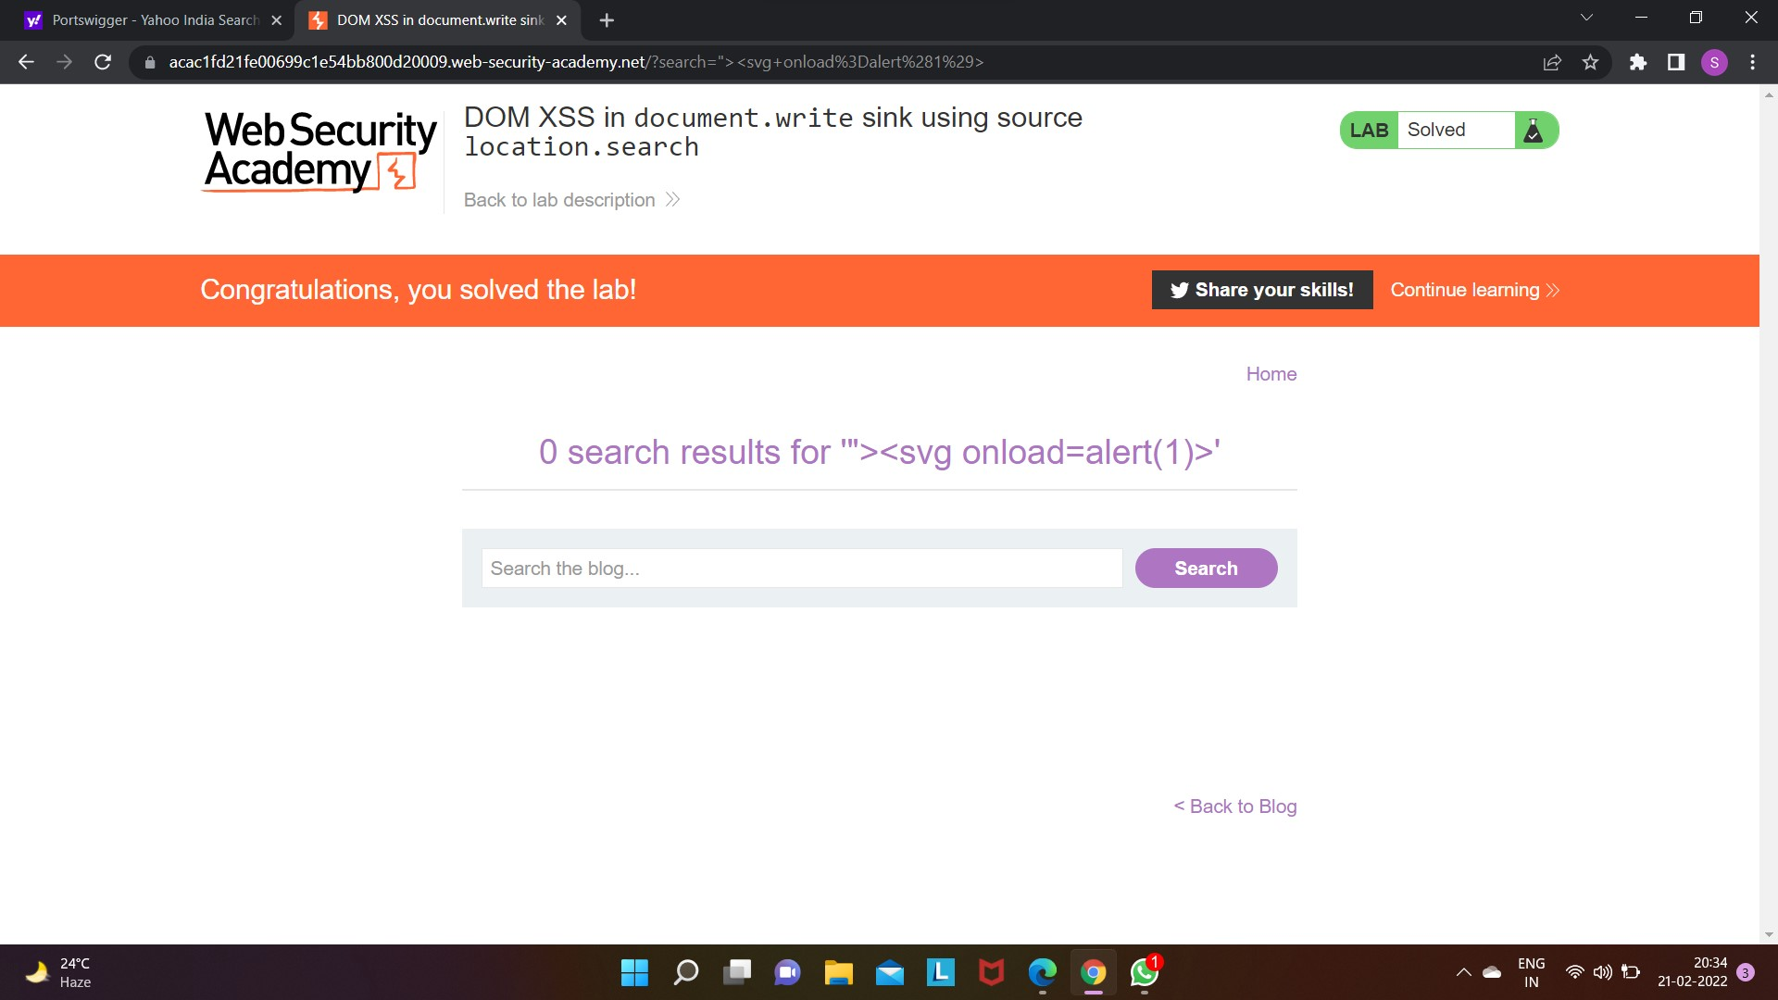

Slide 7
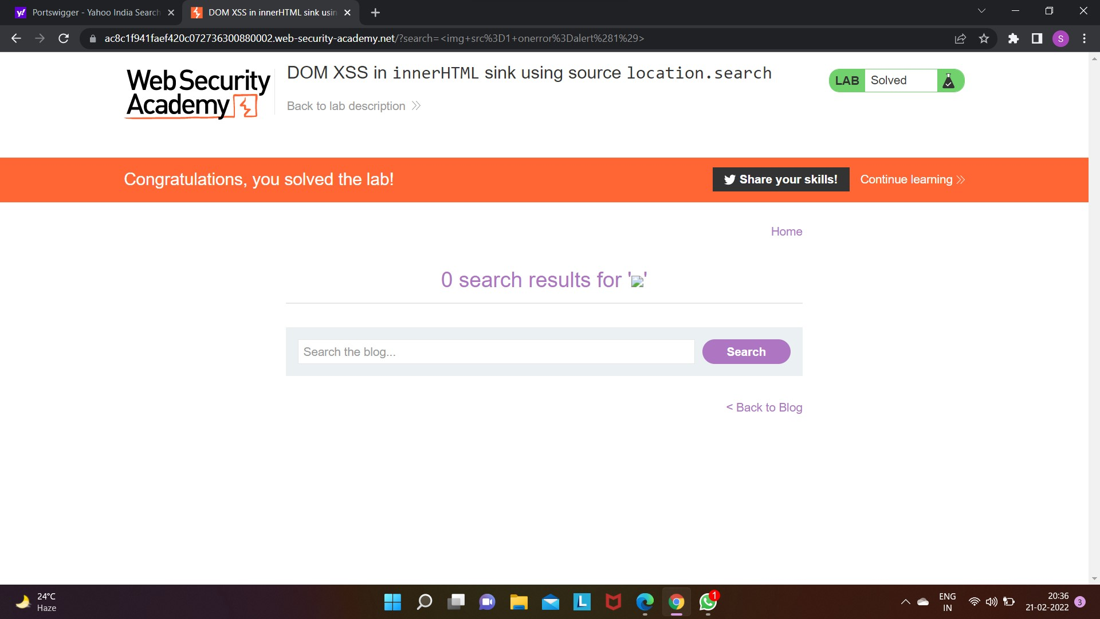
Lab 4 :-

Slide 8
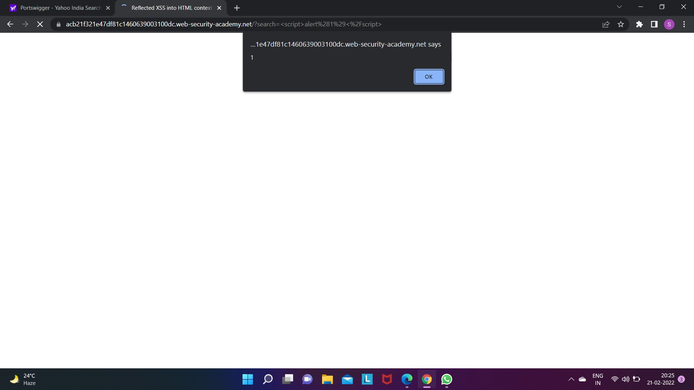
Lab 5 :-

Slide 9
Here task 1 is completed as per the guidelines of Internship Studio. All XSS lab in above slides had been solved. *Lab1 *Lab2 *Lab3 *Lab4 *Lab5
DOMAIN: All labs | Web Security Academy (portswigger.net)

